Slide 1
ALL IN ONE MACHINE LEARNING WEB APP
Name - Samarth Sarin
Course - Mtech AI
Roll No. – R005
Mentor – Prof. Siba Panda

Slide 2
Problem Statement
Developing a User Friendly web based application which will help users to perform all Machine Learning Algorithms with only few clicks without writing any code.
The main idea is to provide the user the basic insights of the data and which algorithm will work well on this dataset. Also after analysing the results the user can go deep inside the algorithm to improve the results even more.

Slide 3
Features of the Tool
All Supervised Machine Learning Algorithms.
Feature Selection and Dimensionality Reduction
Visualizations
Detailed report will be generated
Report will include:
    Algorithm Results
    Visualizations
    Results interpretations
    Result Improvement Suggestions

Slide 4
Pre-Processing Techniques
Handling Missing Values:
  Replacing by Mean
  Replacing by Median
Scaling the Data
  MinMax Scaler
  Standard Scaler
  Robust Scaler
Notes:
Preprocessing Techniques

Slide 5
List of Algorithms Available
Linear Regression
Ridge and Lasso Regression
Logistic Regression
Decision Trees
Random Forest
K Nearest Neighbours
Support Vector Machines
Principal Component Analysis
Feature Selection Techniques
Principle Component Analysis
Random Forest Feature Importance
Notes:
Add unsupervised

Slide 6
Visualization
Distribution Plot
Bar Plot
Scatter Plot
Heat Map
Box Plot
Violin Plot
Count Plot
Pair Plots

Slide 7
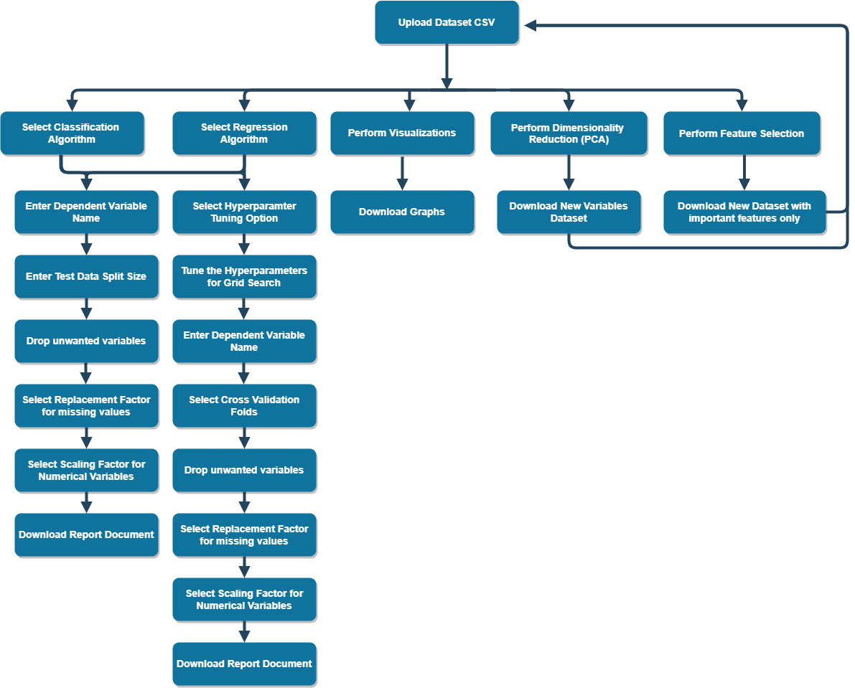
Notes:
Change color

Slide 8
Steps (With Default Parameters)
Upload Dataset in CSV Format
Select different algorithms that user wants to perform
Enter the name of Dependent Variable
Select Variables which the user wants to drop.
Select parameter to fill missing values (Mean, Median)
Enter test split size.
Analyse the Results.
Notes:
3 steps at a time

Slide 9
Steps (With Default Parameters)
Enter the name of Dependent Variable
Select Variables which the user wants to drop.
Select parameter to fill missing values (Mean, Median)
Enter test split size.
Analyse the Results.
Notes:
3 steps at a time

Slide 10
Steps (With Hyper parameter Tuning)
Upload Dataset in CSV Format.
Select different algorithms that user wants to perform
Select Interested in Hyper parameter tuning option on Algorithm page
Enter the name of Dependent Variable
Enter Cross Validation Size
Select Variables which the user wants to drop.
Select parameter to fill missing values (Mean, Median)
Select value for cross validation.
Select all the Hyper Parameters for Tuning.
Analyse the Results.

Slide 11
Python Dependencies
Flask for Python and HTML Integration
Scikit-learn for Machine Learning Algorithms
Matplotlib and Seaborn for Visualizations
Docx for Report Generation
HTML and CSS for Website development.

Slide 12
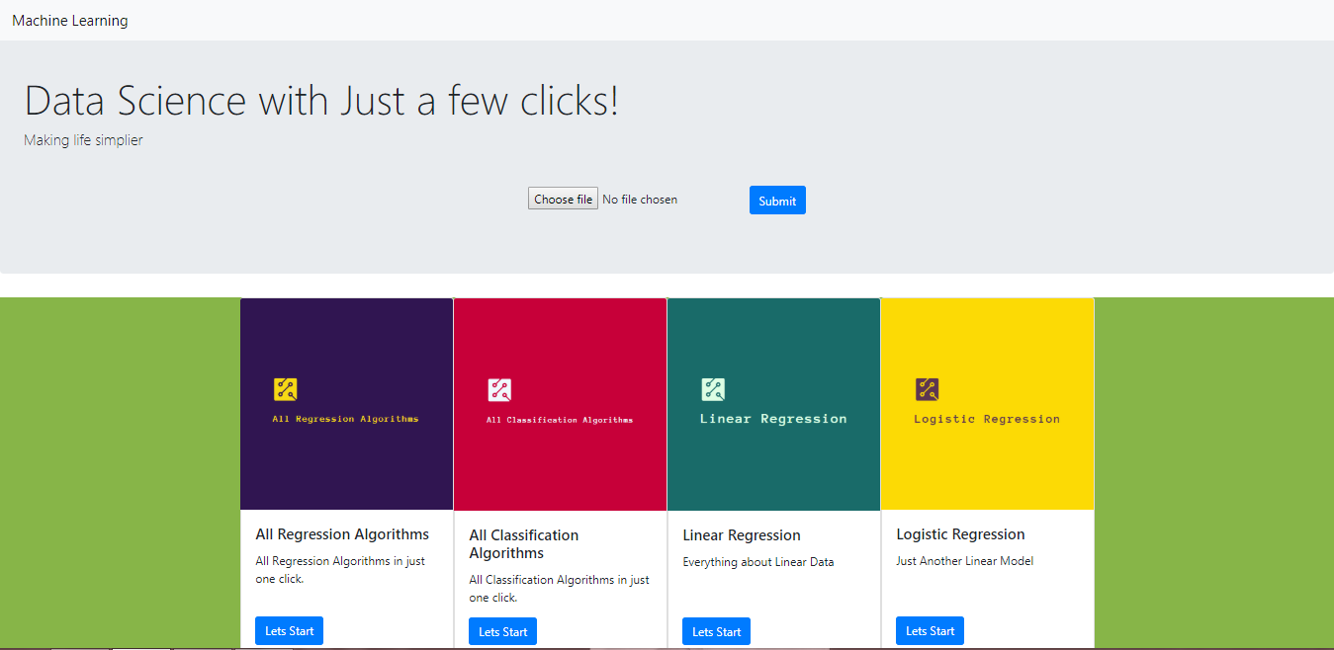

Slide 13
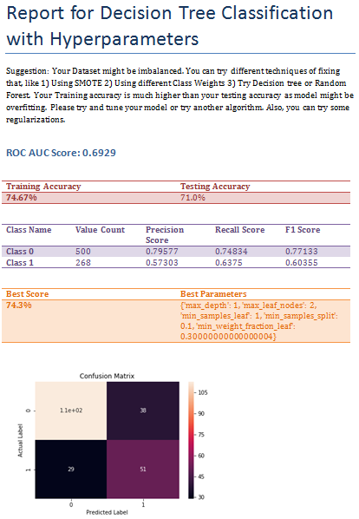

Slide 14
Future Scope
Adding Unsupervised Machine Learning Algorithms
Adding more complex algorithms like Adaboost and XGBoost
Interactive Visualization Support with more interactive tools.

Slide 15
THANK YOU

